Slide 1
Lye Brook SubCommittee Field Trip
August 2016

Slide 2
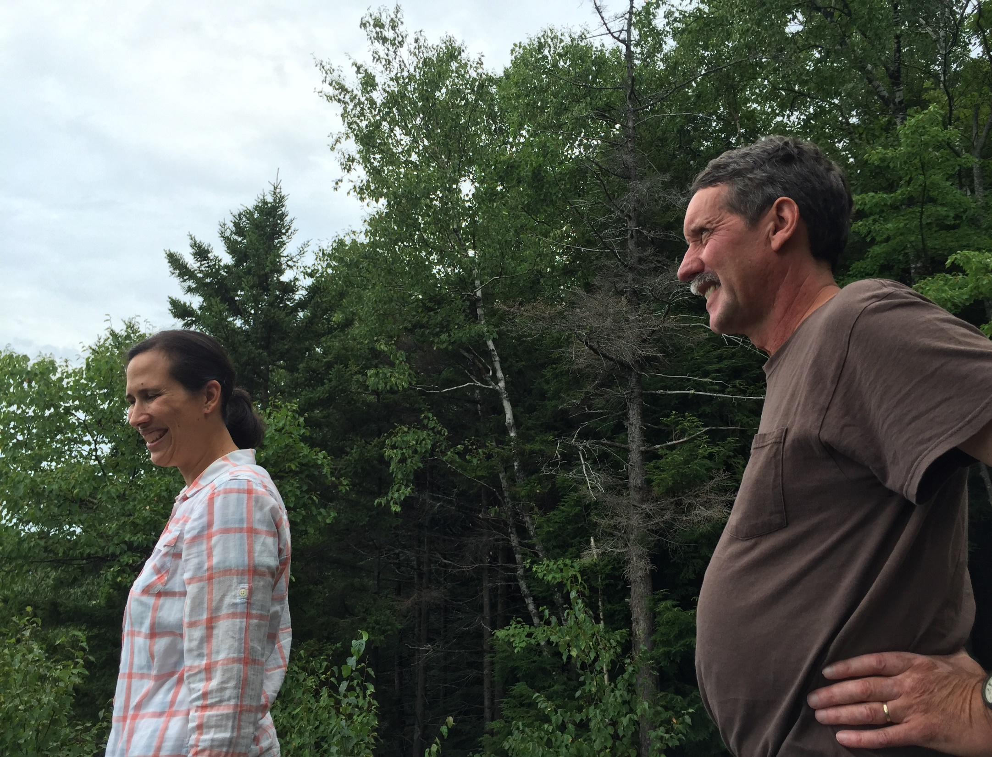
Field Trip Crew
Jennifer Wright, U.S. Forest Service
Jim Kellogg, State of VT, Agency of Natural Resources
Judy Rosovsky, University of VT

Slide 3
OUR MISSION:
Visit Prospect Rock wilderness area to observe air quality
Hike along Branch Pond Trail and portions of the historic railroad bed
Observe Bourn Brook
Proceed to Douglas Shelter
And time permitting, observe wetland adjacent to Little Mud Pond

Slide 4
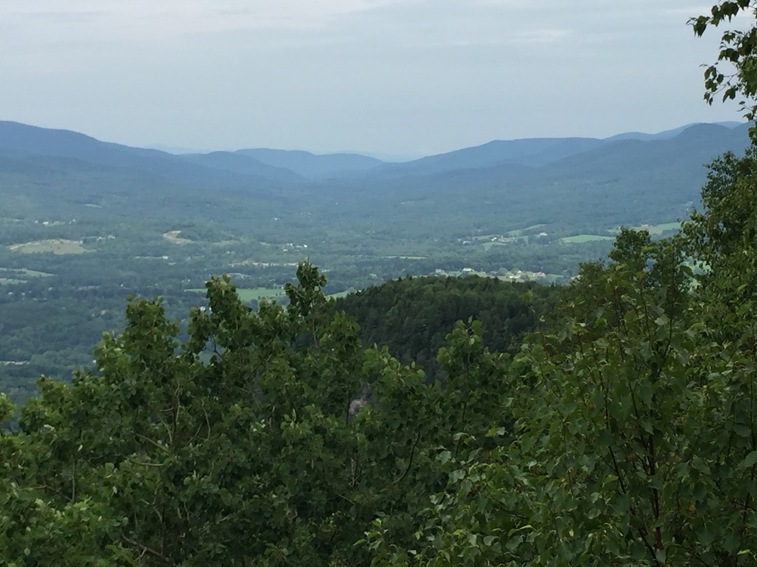
Air quality as seen from Prospect Rock was quite good on Bennington Battle Day, August 16, 2016.
Note the very faint farthest mountain below the yellow arrow. If that is visible, air quality is high.
View from Prospect Rock looking out toward Manchester VT

Slide 5
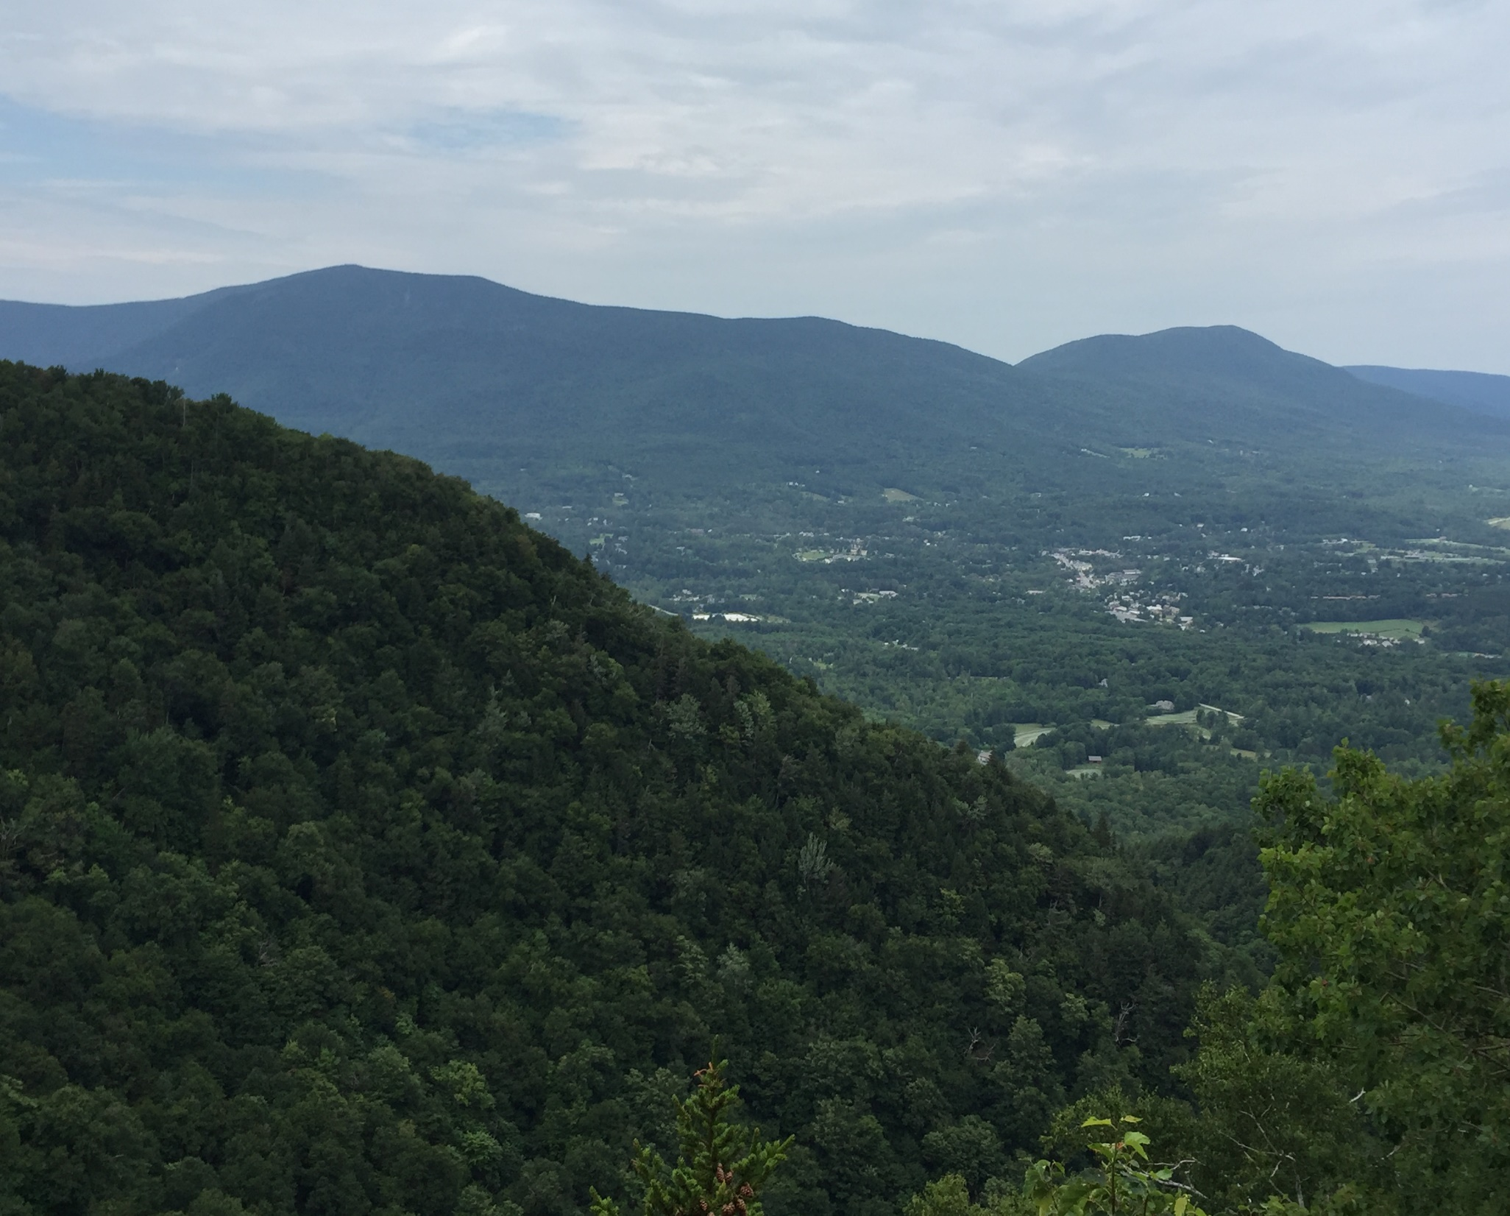
On poor air quality days, the haze can obscure Mt Equinox.
Sulfur bearing particulate matter is responsible for much of poor air quality, and the Clean Air Act has generated significant reductions in sulfur based particulate matter.
Mt. Equinox

Slide 6
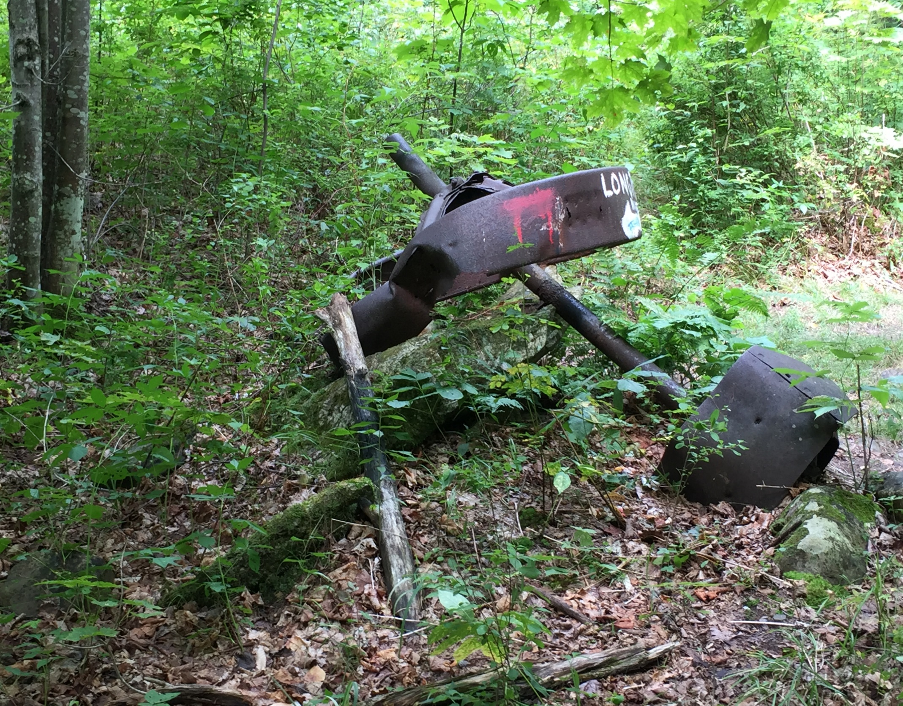
The area that the trail goes through used to be farmed. Old pieces of equipment, like the one pictured here, and cellar holes can be seen.

Slide 7
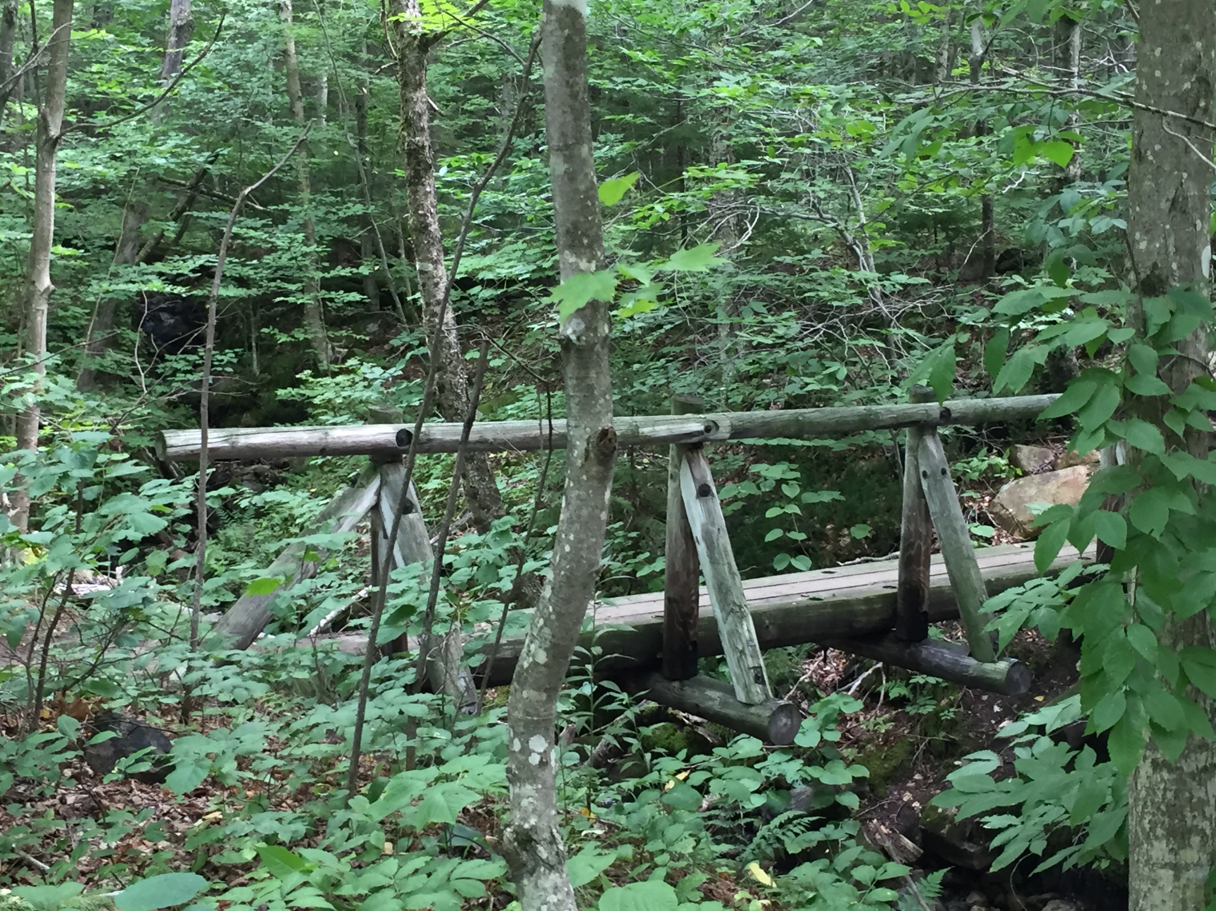
This artifact is recent

Slide 8
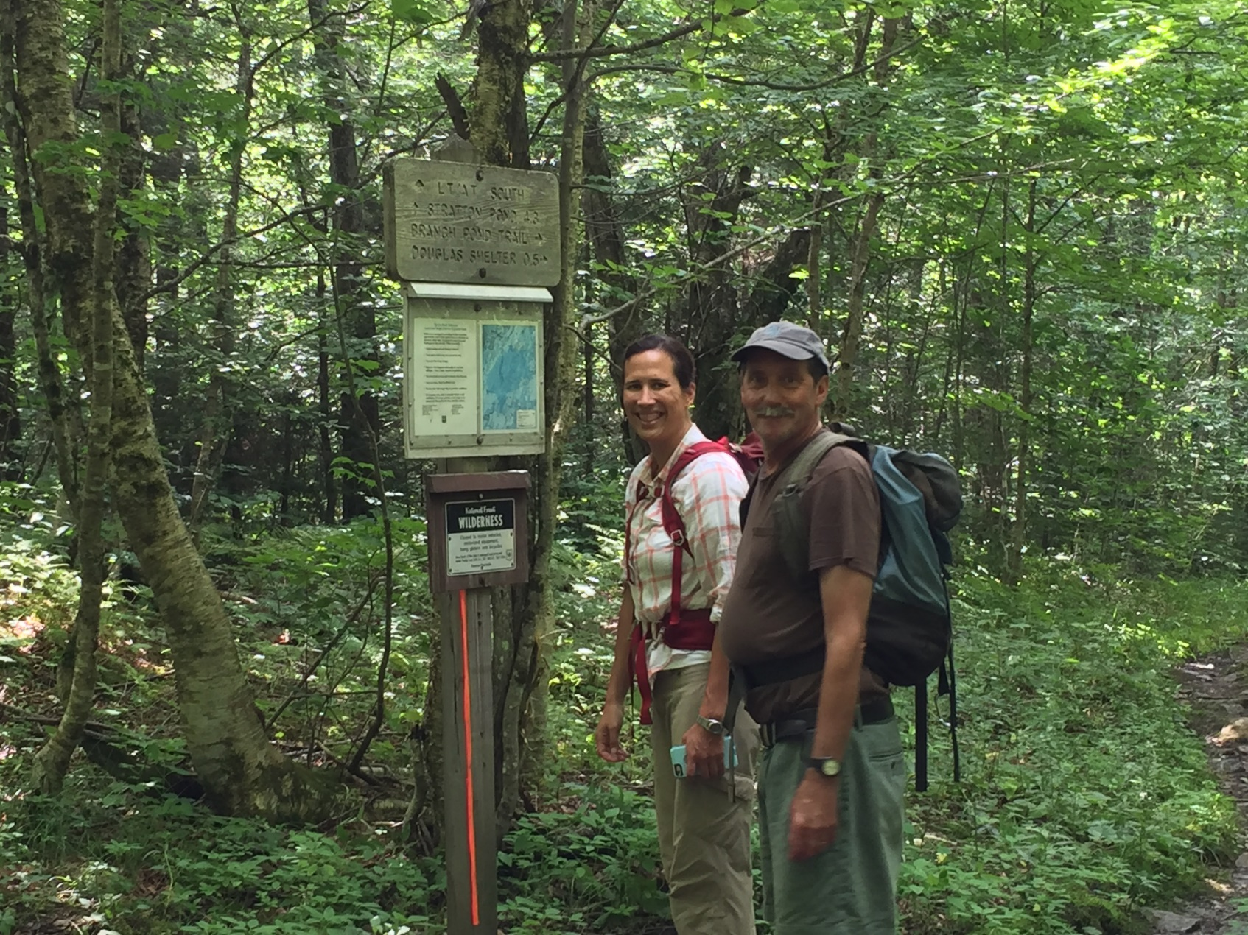
At the trail intersection we crossed into the Lye Brook Wilderness Area.

Slide 9
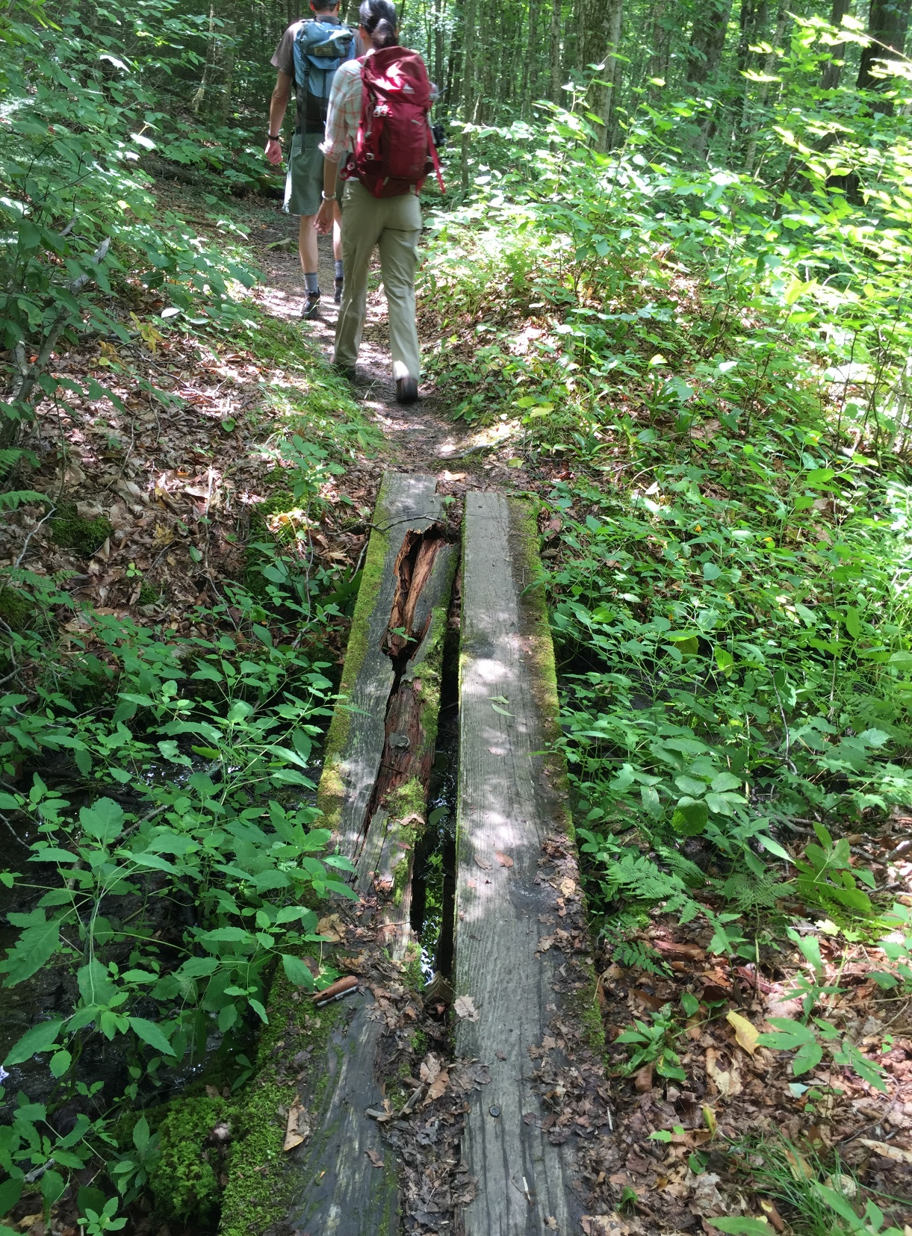
Note that the boards that are starting to rot out. The level terrain limits drainage, and the dense canopy keeps moisture in, which limits boardwalk life and increases the labor intensity of trail maintenance.

Slide 10
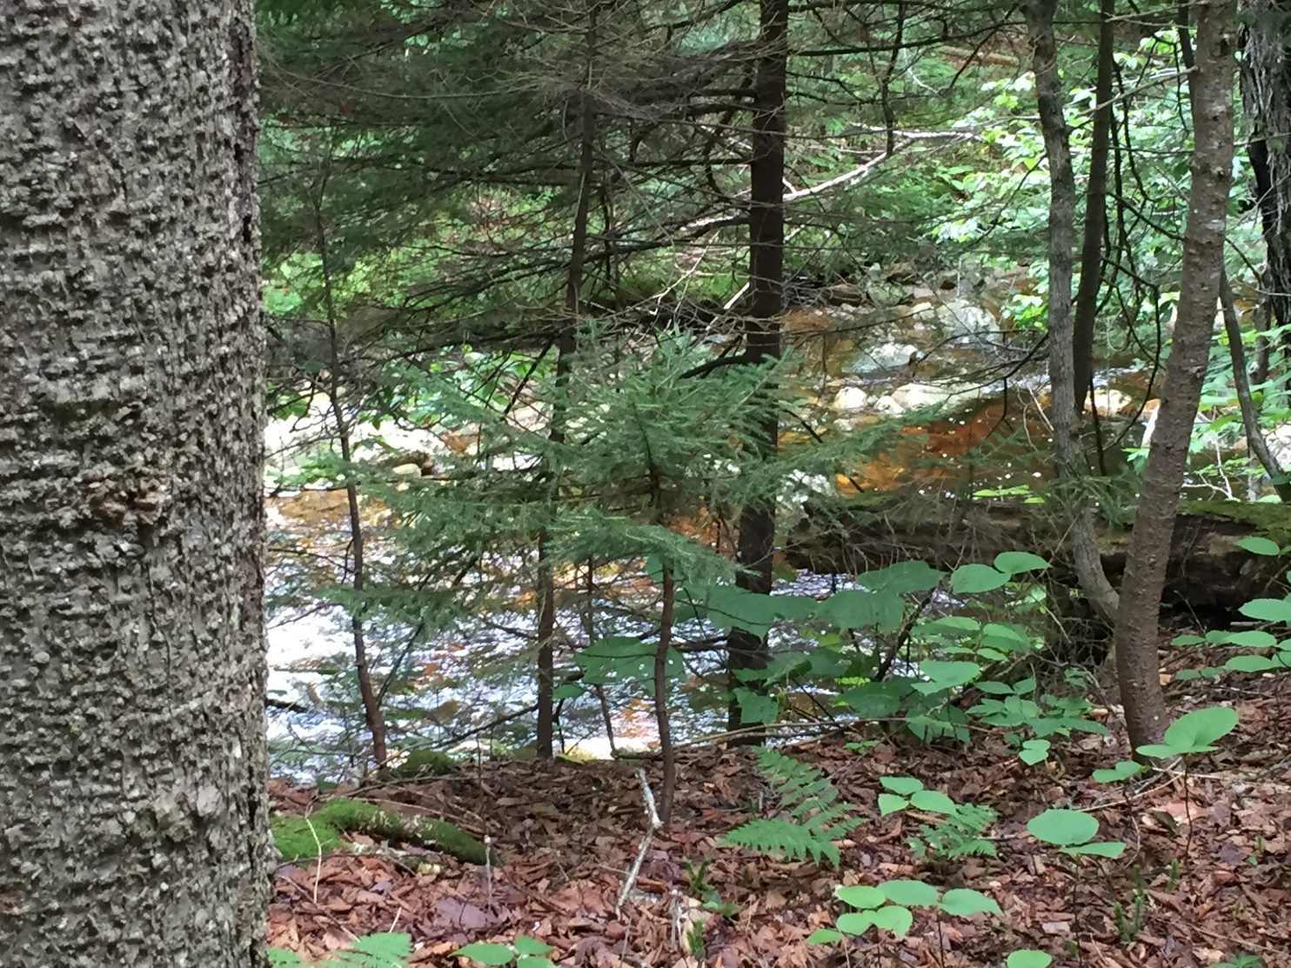
This trail follows an old railroad bed. Part of the trail will be re-routed to move it further from Bourn Brook. In many places the brook has a good buffer zone between it and the trail, but in some places the trail is fairly close to the brook.

Slide 11
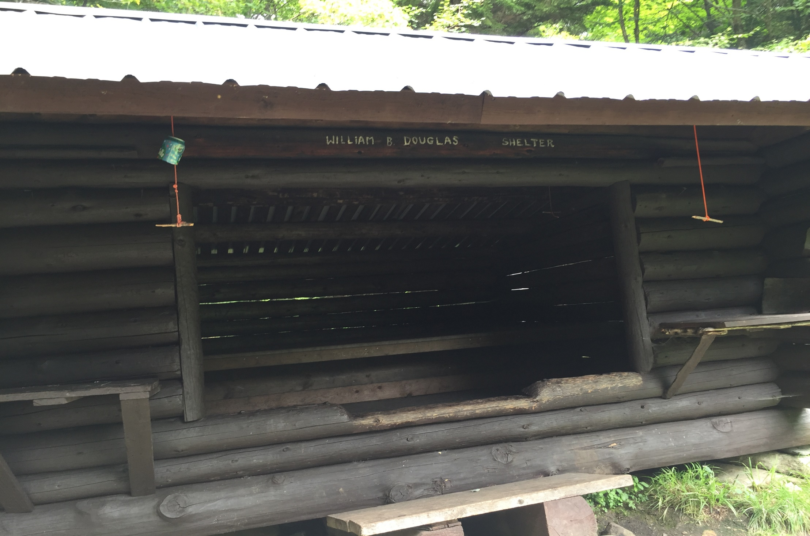
We arrived at the Douglas Shelter and took a look around.

Slide 12
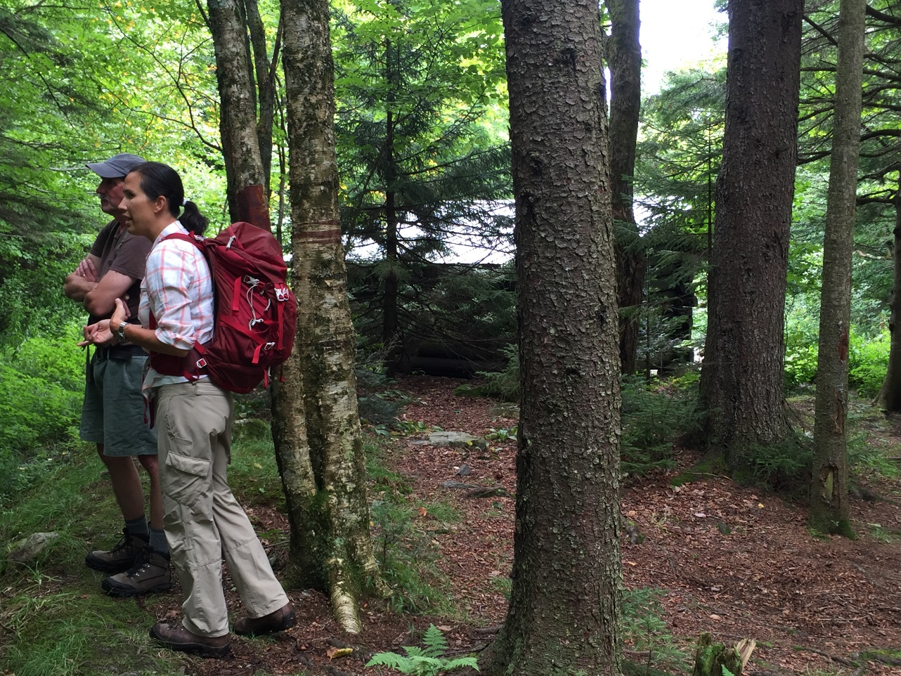
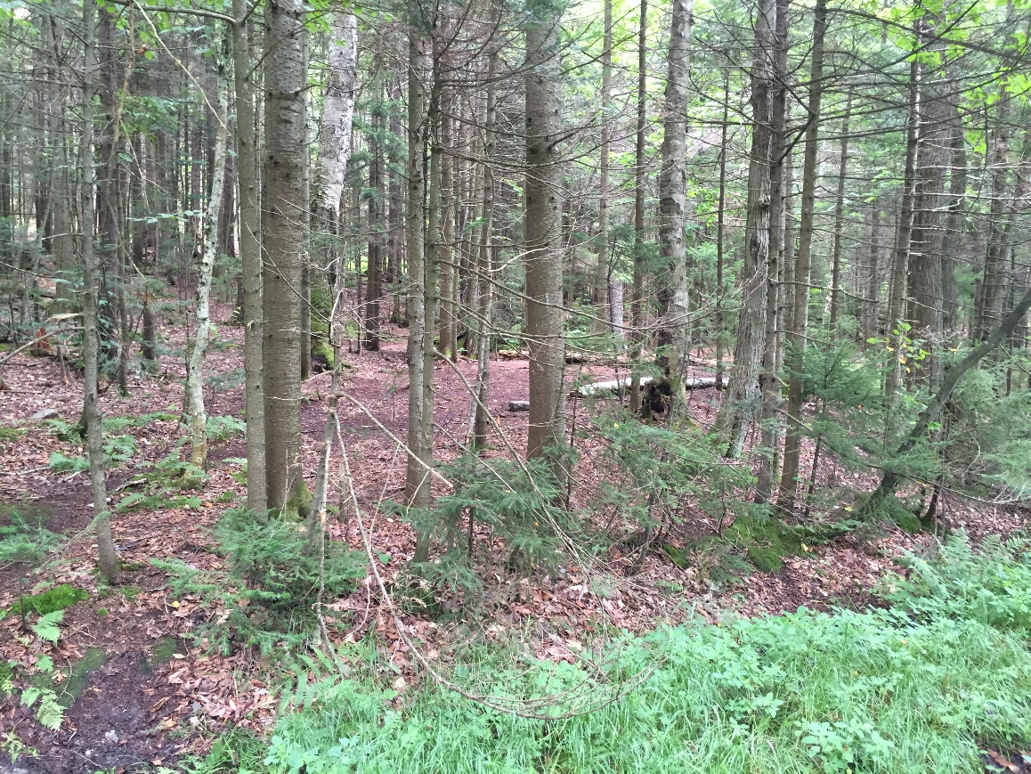
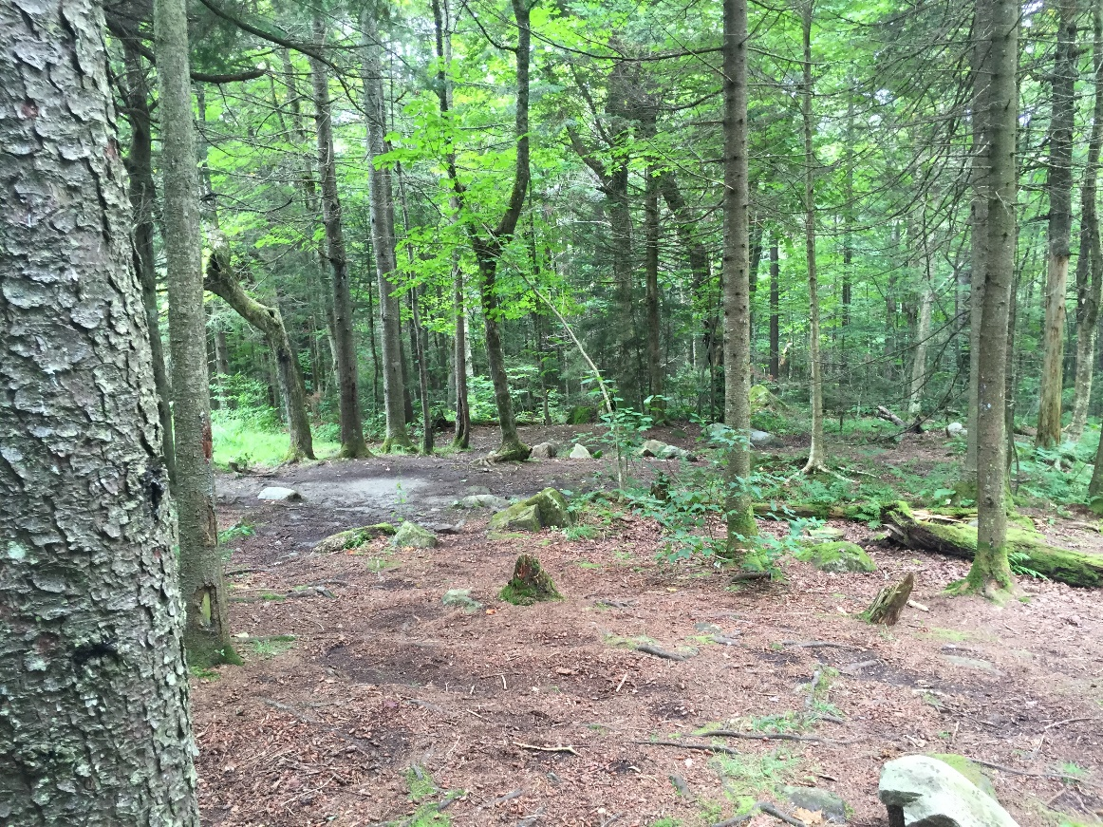
Some of the things to consider at a shelter are the number of people who arrive expecting to camp at that location. If the shelter is full, people camp in the woods nearby, making obvious tenting sites in the wilderness area.
Is it better to disperse people so they are not heavily using one area, or is it best to keep the damage contained to one area, with occasional shut downs or diversion to allow a place to recover?

Slide 13
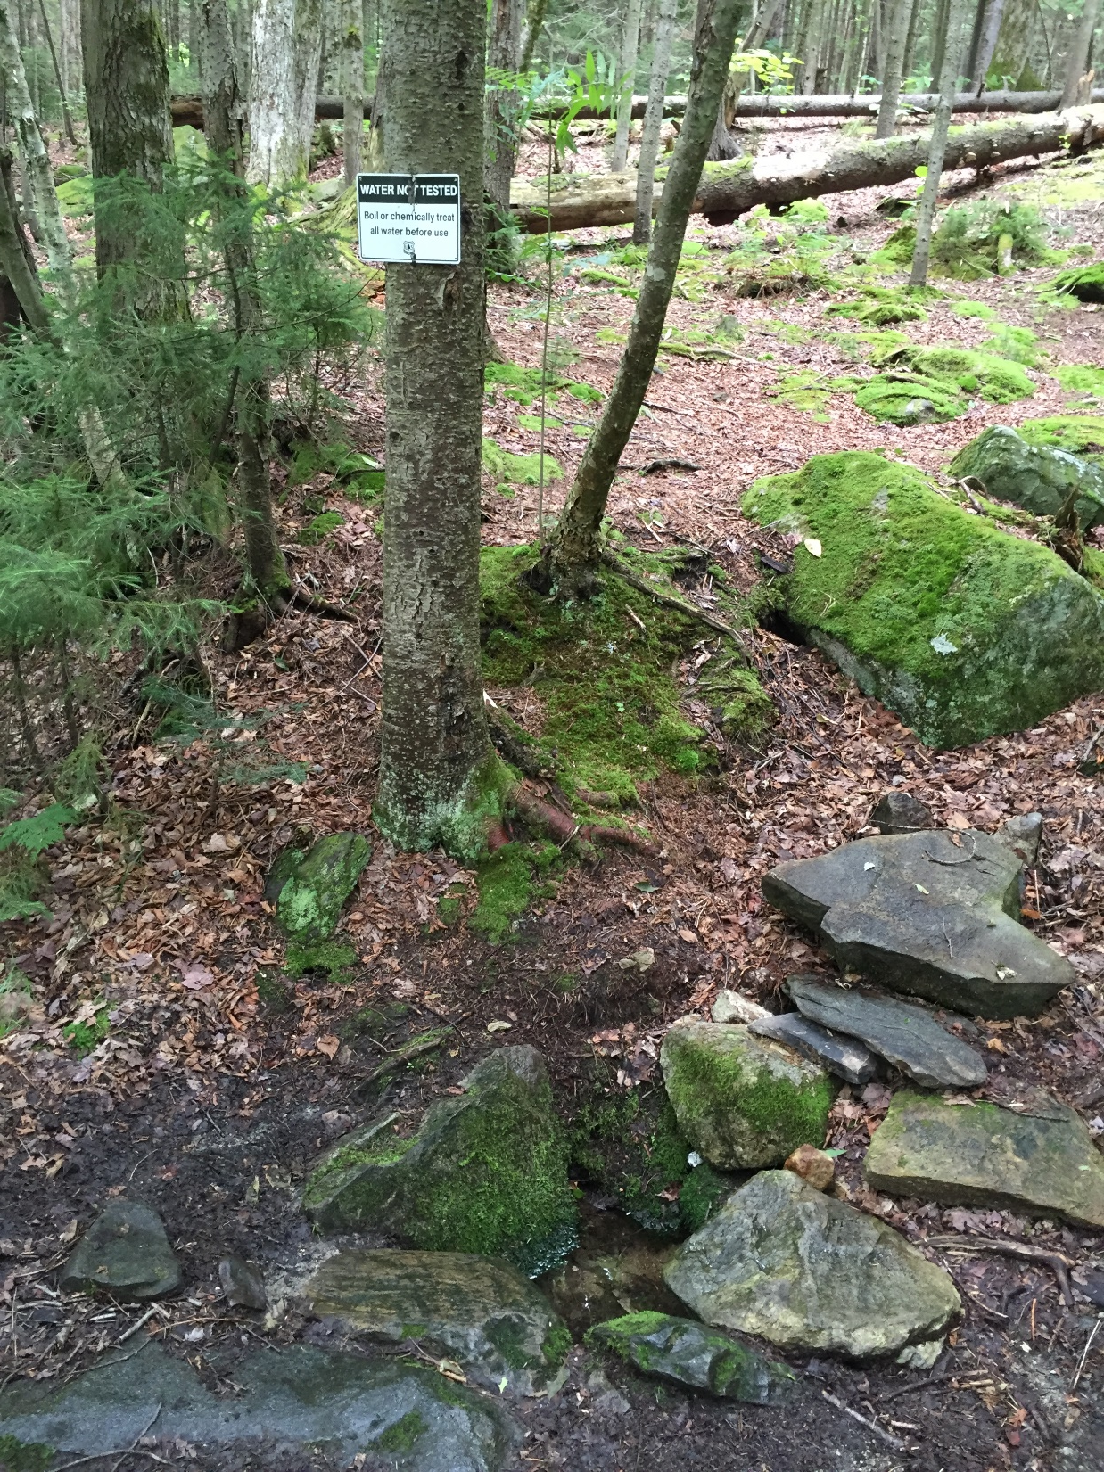
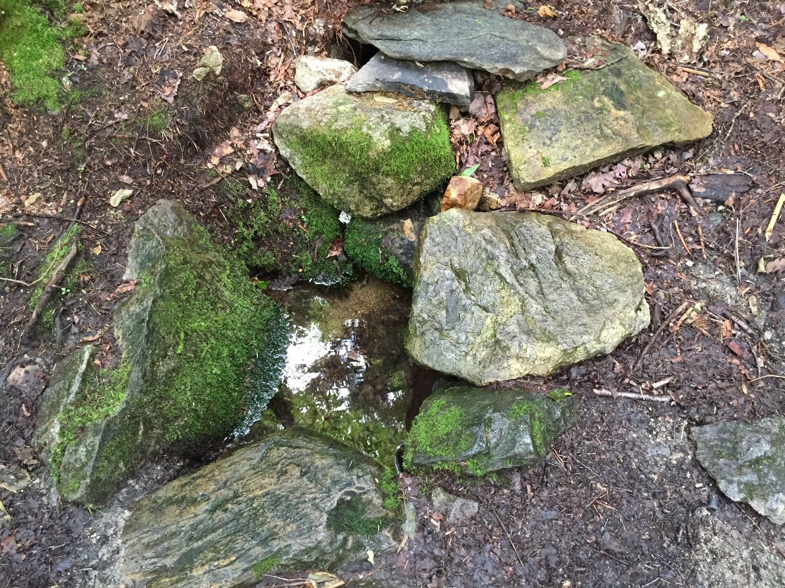
Water and access to water is another concern. The water level is fairly low at this time of year (August).

Slide 14
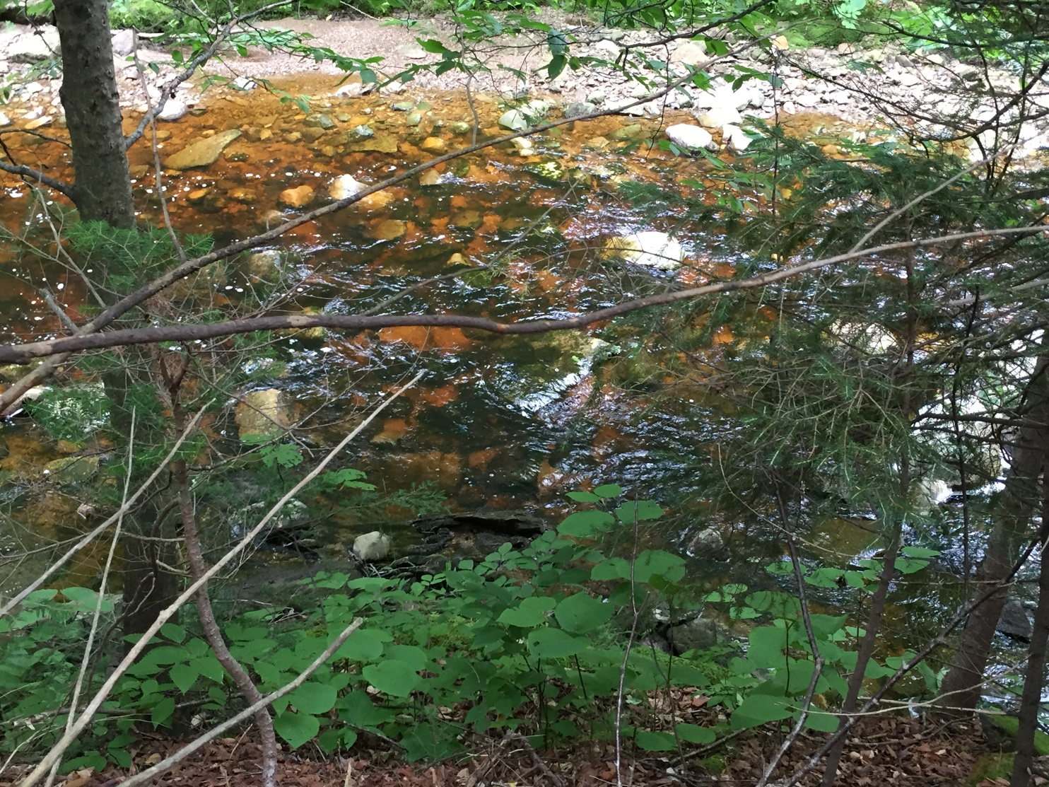
The water quality of Bourn Brook is quite high. Jim Kellogg was instrumental in advocating for the designation of the section of Bourn Brook that is in the wilderness area to be classified as an A-1 body of water.

Slide 15
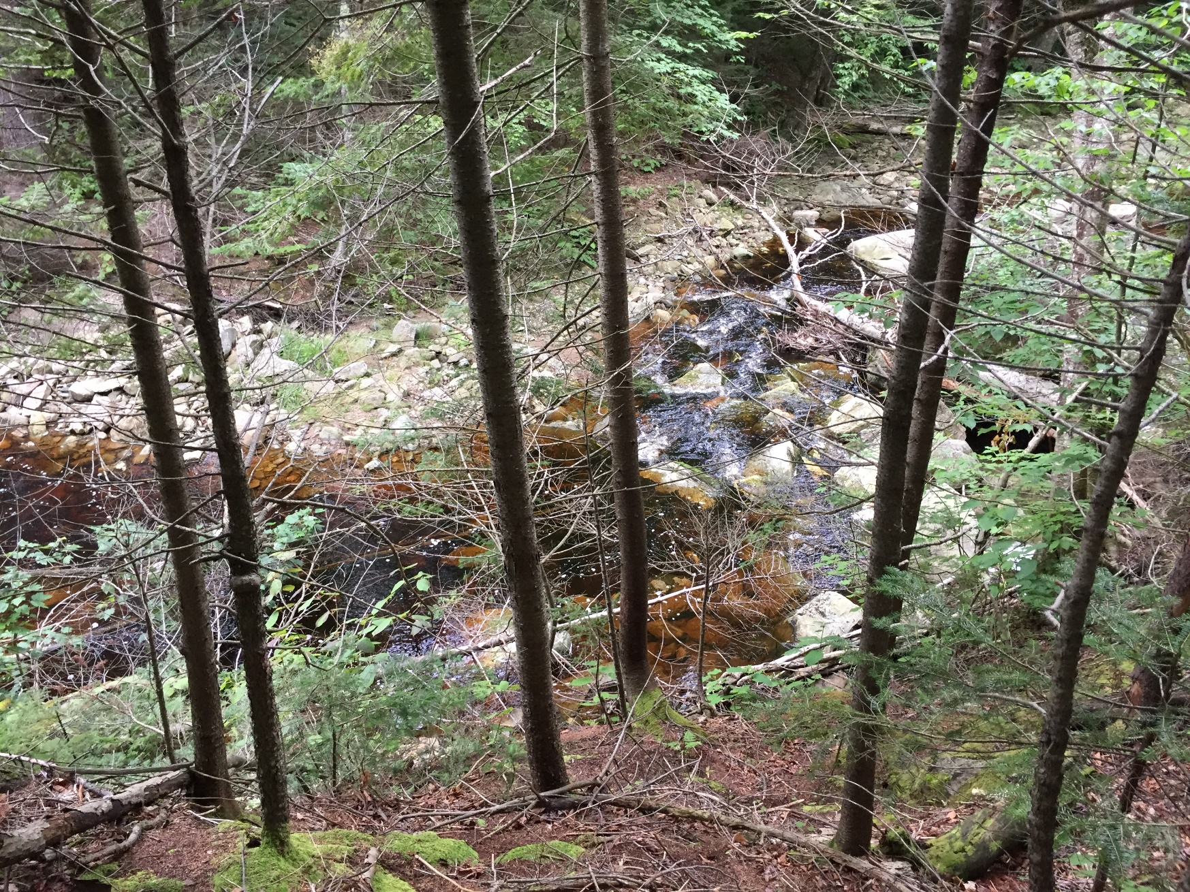
Bourn Brook offers high water quality and a variety of habitat types to its denizens. Note the fallen woody debris, the deep pools and the rocks of different sizes.

Slide 16
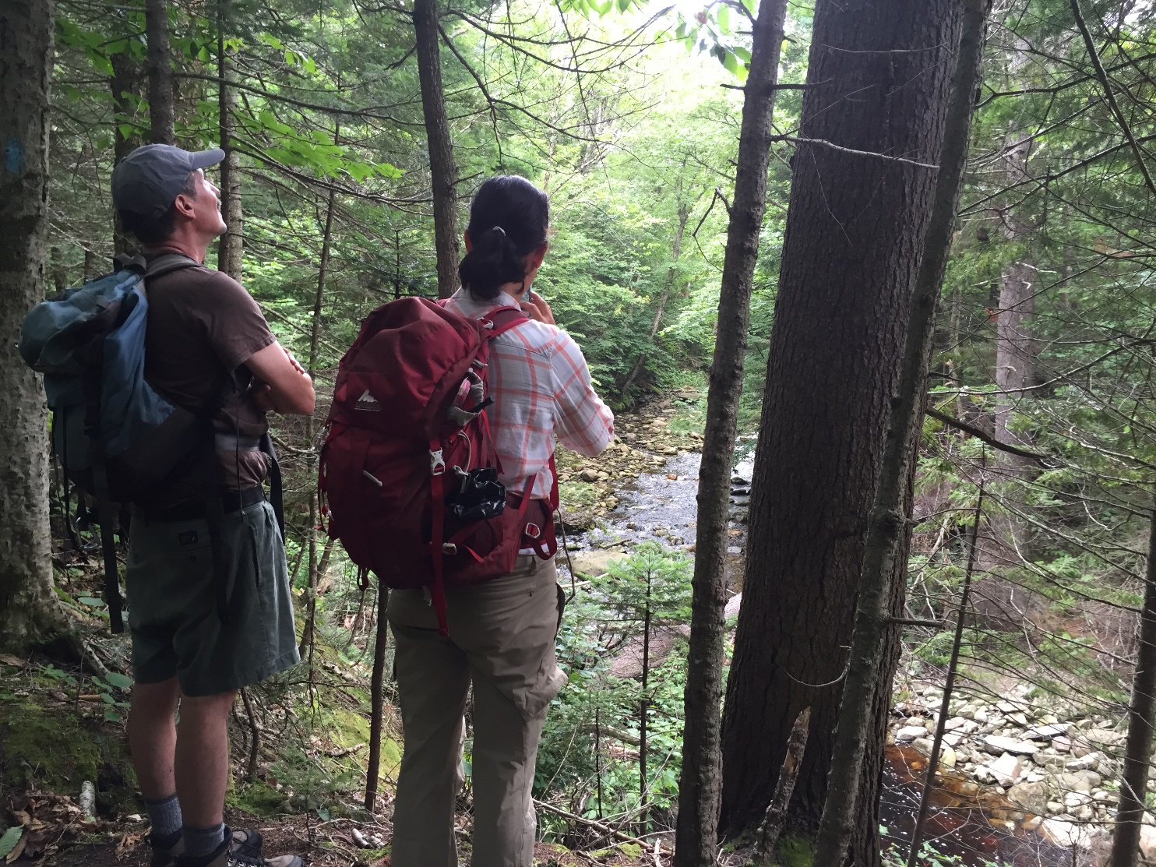
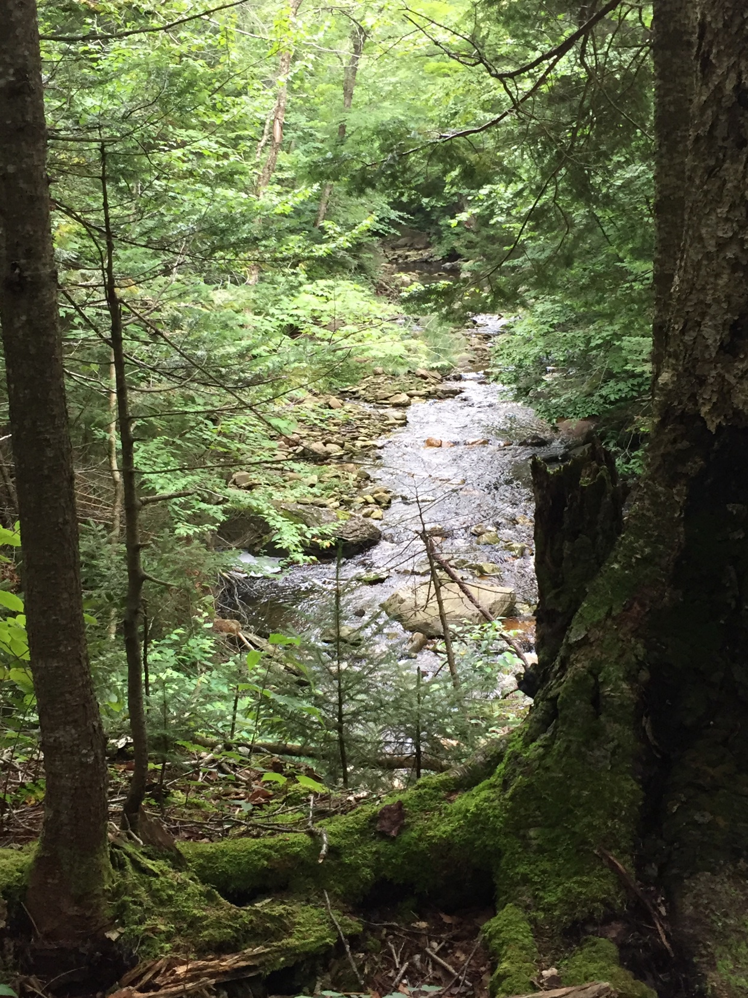
The brook has a few long straight passages, which is something that is not often seen on most high elevation Vermont brooks.

Slide 17
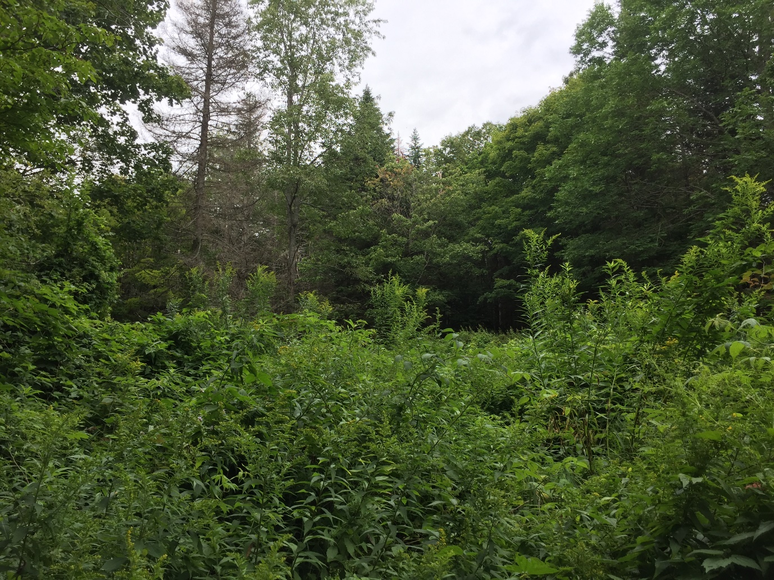
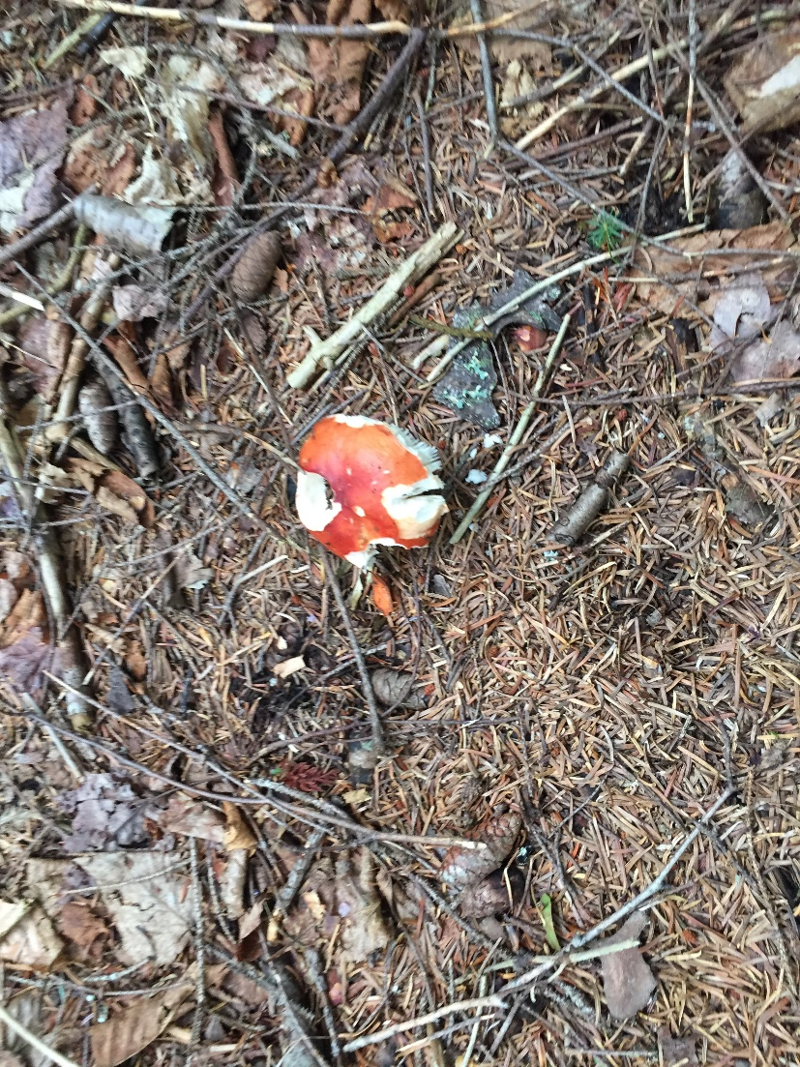
An opening in the woods with an old cellar hole, and a Russula emetica that provided a snack for a chipmunk.

Slide 18
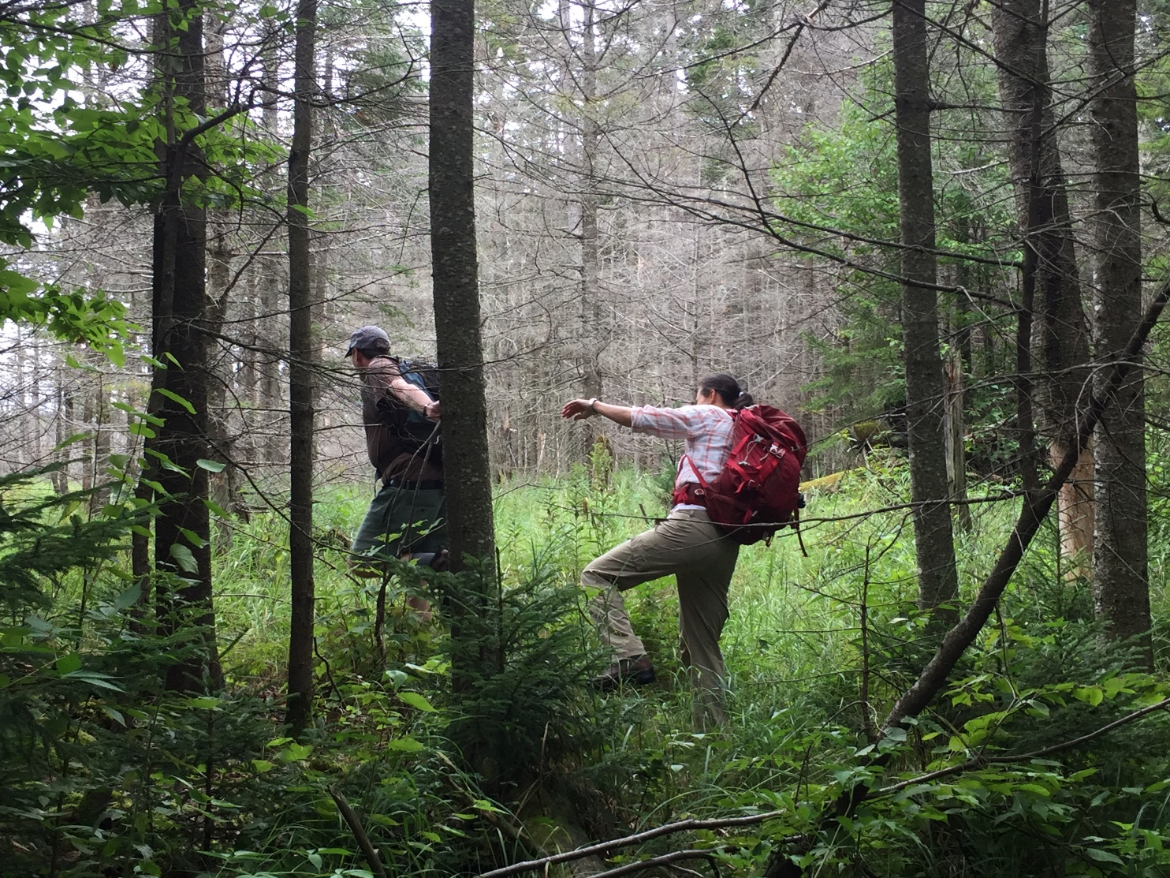
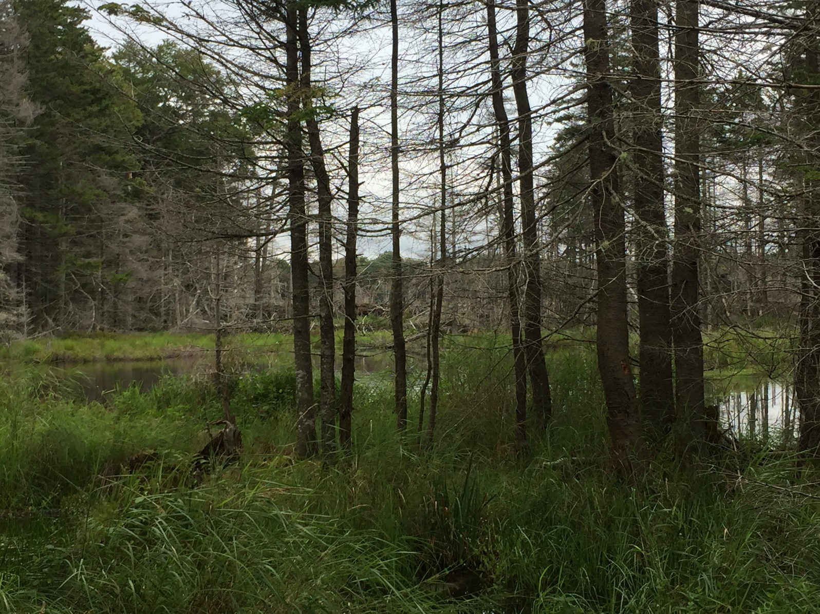
This area is now draining onto the trail.
A slog through the bog got us to the outskirts of Little Mud Pond, where we were able to observe wetland vegetation such as Kalmia and Spirea.

Slide 19
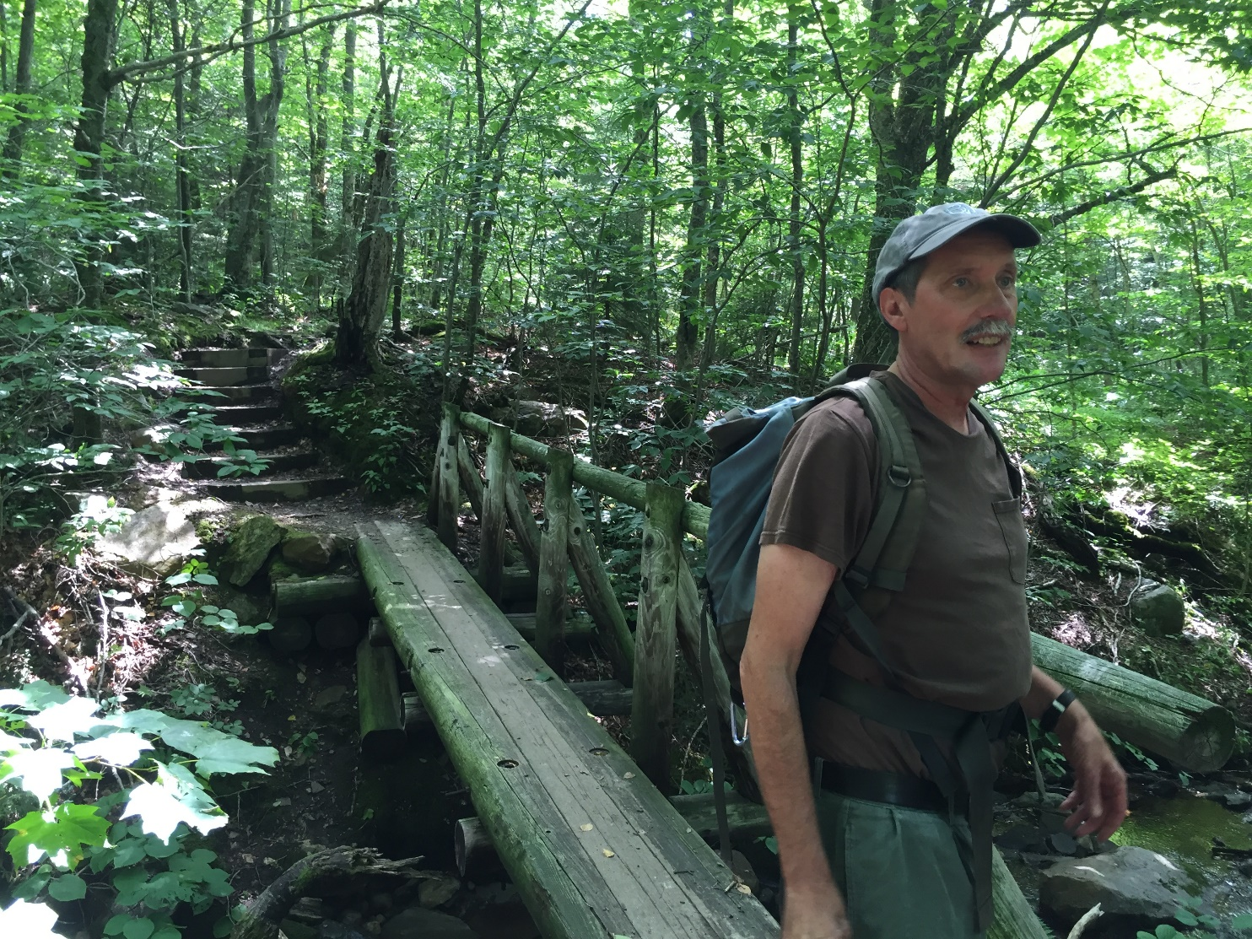
Hope you enjoyed this trip, and maybe we’ll see you on the trail soon!

